Slide 1
Video Game Sales
Storytelling

Slide 2
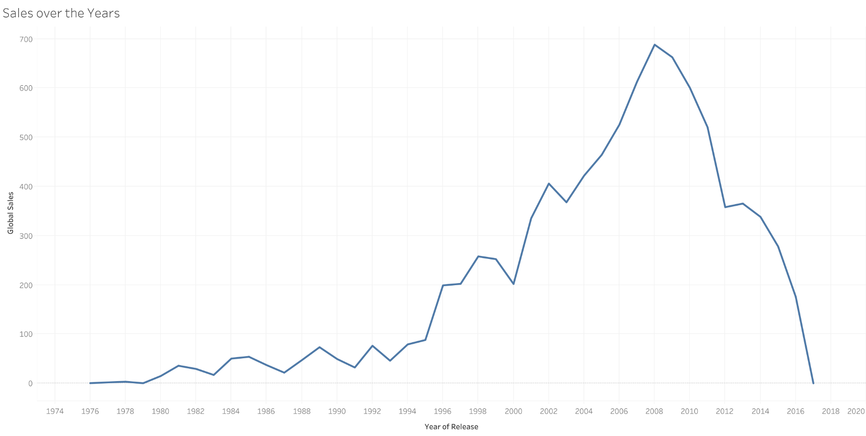
What is the Global Sales over the years?
From the plot we can see that,
Video games were not that hit during mid 20th Century.
Minimum global sales occurred in 1960s which was 0.44 millions.
Maximum global sales occurred in 2008 which was 688.30 millions.
Average global sales were 0.51 millions.
We can see that sales data is Negative skewed.

Slide 3
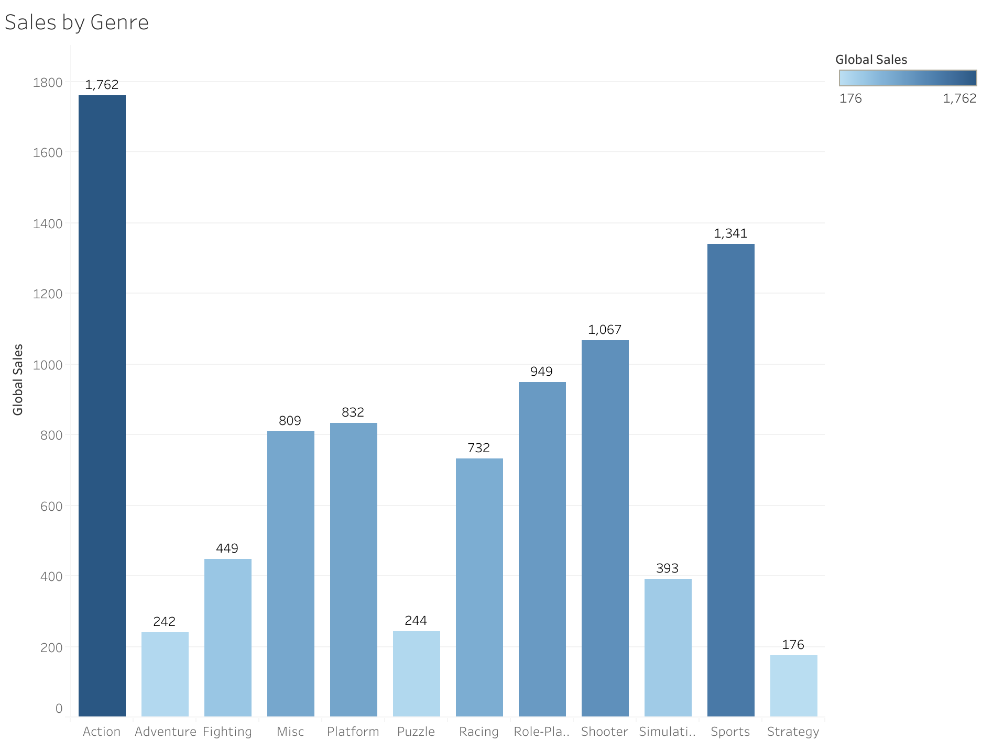
Which type of Genre has most global sales?
From the plot we can see that,
Most sales is done by the Action genre which is 1762 millions worldwide.
This means action genre is liked by most of the users.
Minimum sales is done by Strategy genre which is 176.

Slide 4
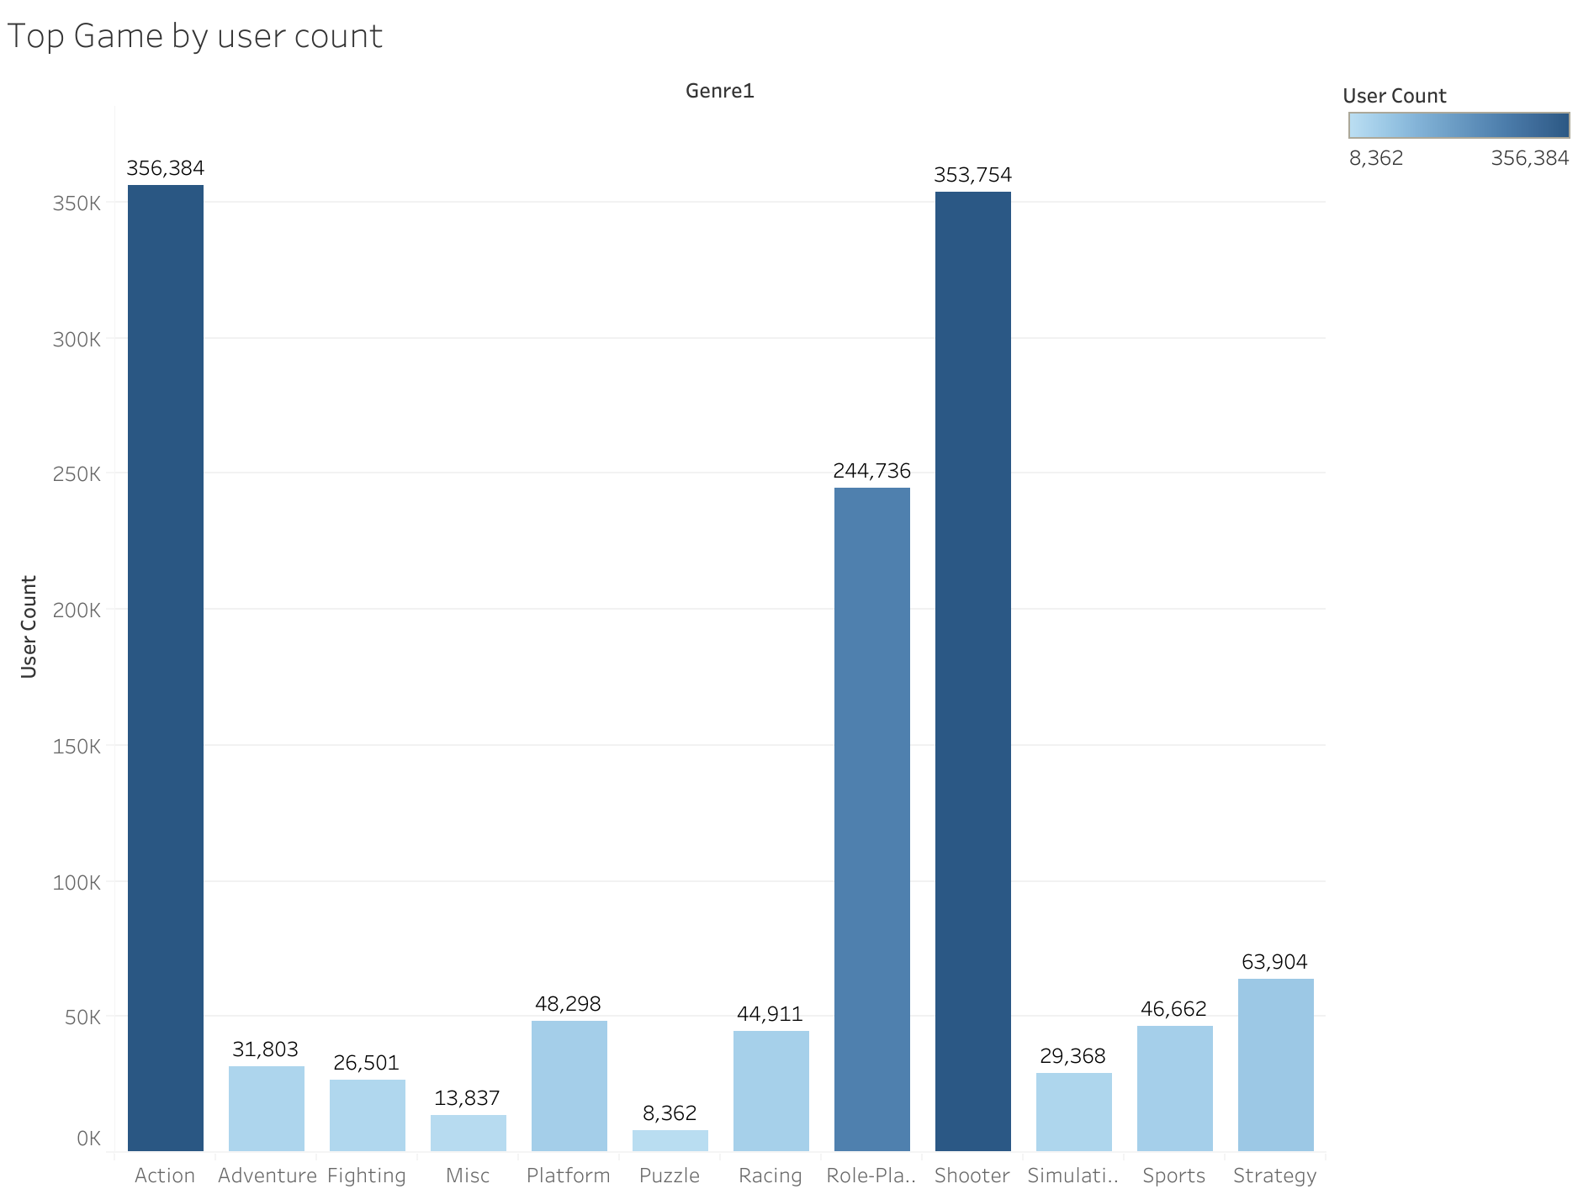
What are the top picks in genre by the user?
From the above plot we can see that,
Most of the users like to play Action genre which is evident as most sales is done by that genre.
But surprisingly, User count for shooting genre is very close to Action genre.
Same is the case for Role Playing games.
This means most of the shooting and Role playing games could be free of cost.

Slide 5
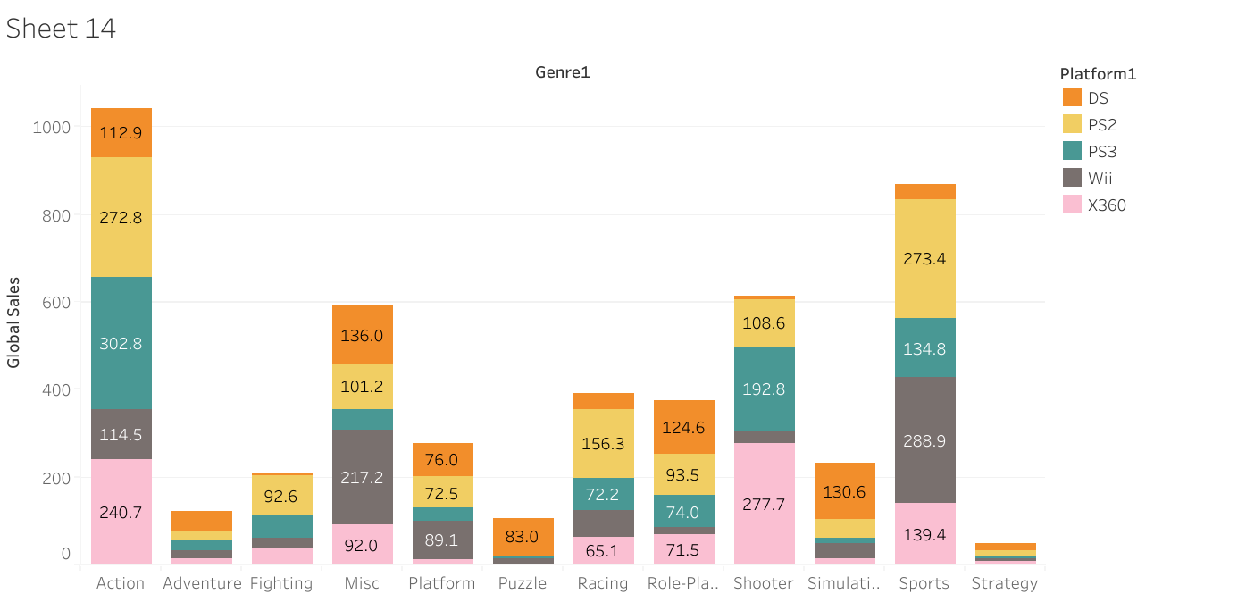
Which is best selling genre on each platform?
Nintendo DS has the highest popularity in the simulation genre
PS2 has the highest popularity in the sports genre action genre coming close to a second spot.
PS3 has the highest popularity in the action genre
Nintendo wii has the highest popularity in the sports genre.
Xbox 360 has the highest popularity in the shooter genre.

Slide 6
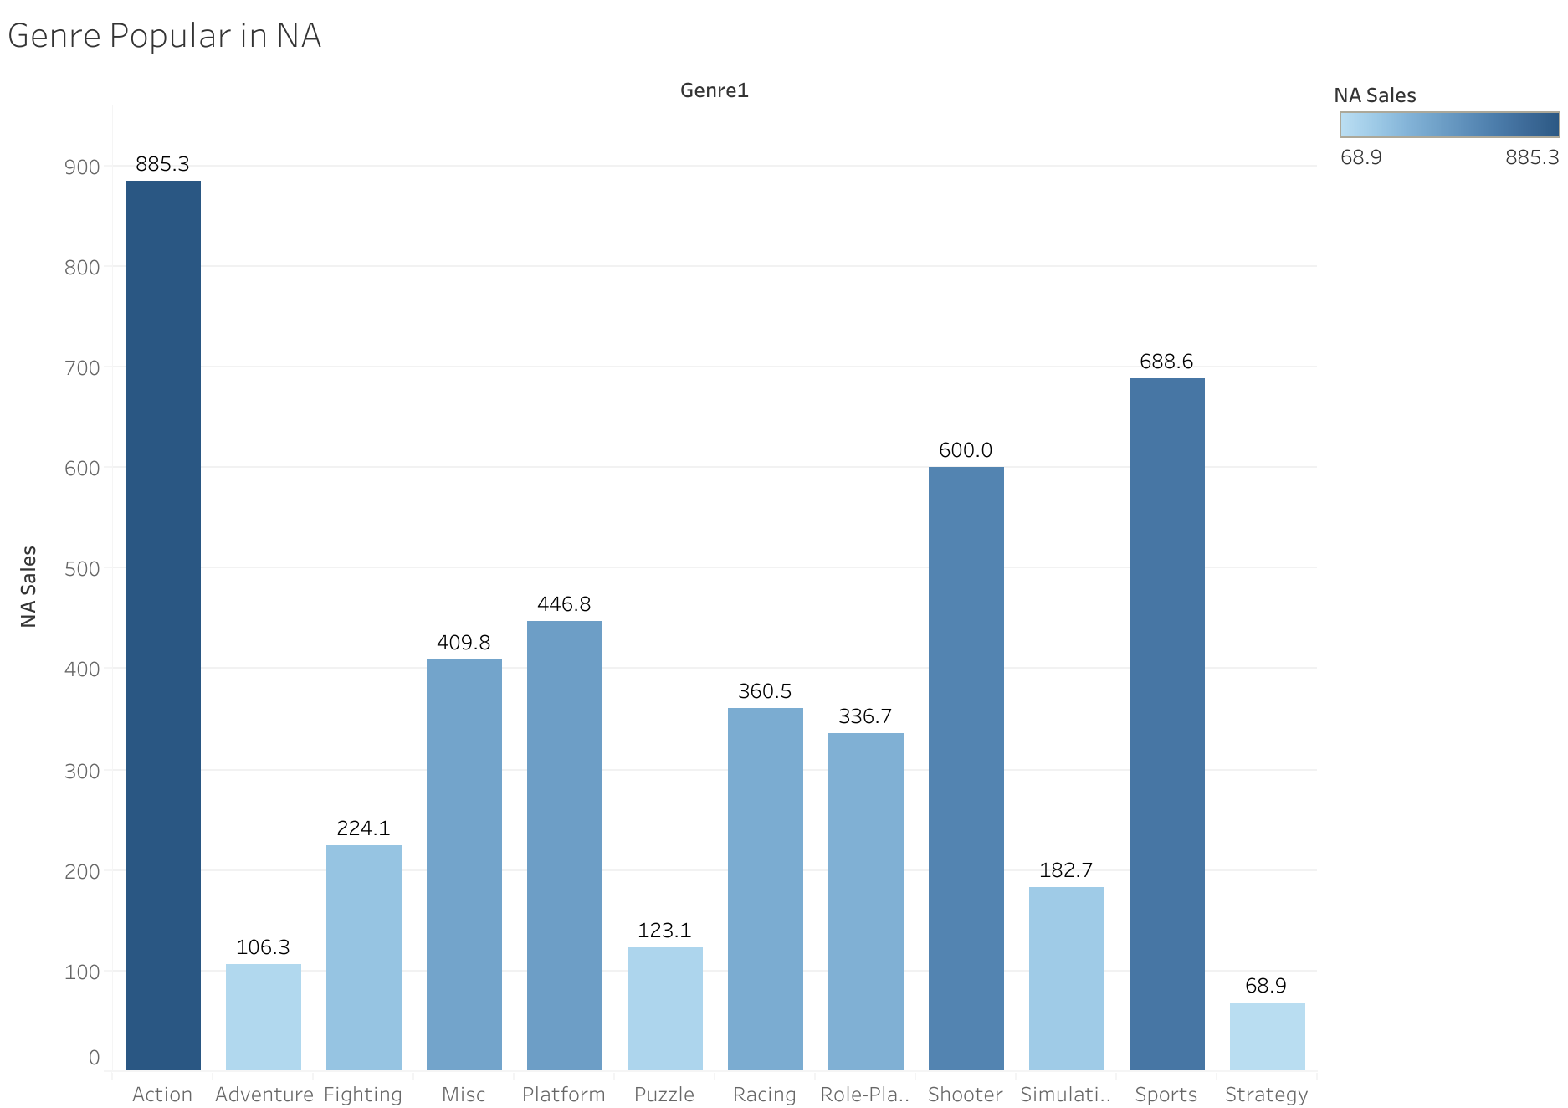
What are top selling games in North America?
From the plot we can see that,
Action Genre is by far the most sold gaming genre in North America.
Strategy gaming genre has the lowest sales in North America.
Misc and Platform gaming genres have the closest share of sales.

Slide 7
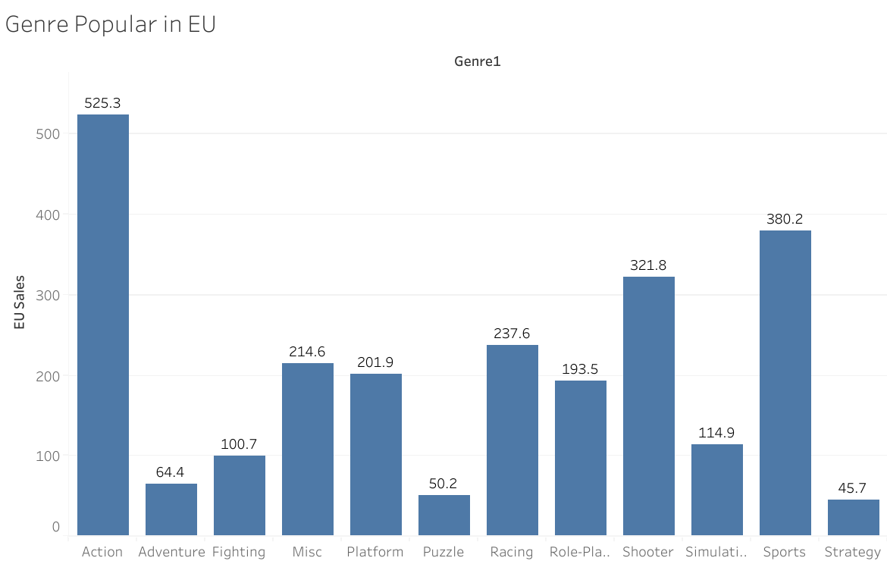
What are top selling games in Europe?
From the plot we can see that,
Action is the most sold genre in Europe with the sales of 525.3 millions.
Sports is second most sold genre in Europe with the sales of 321.8 millions.
Least sold games according to the genre is Strategy games with a sales of 45.7 millions.

Slide 8
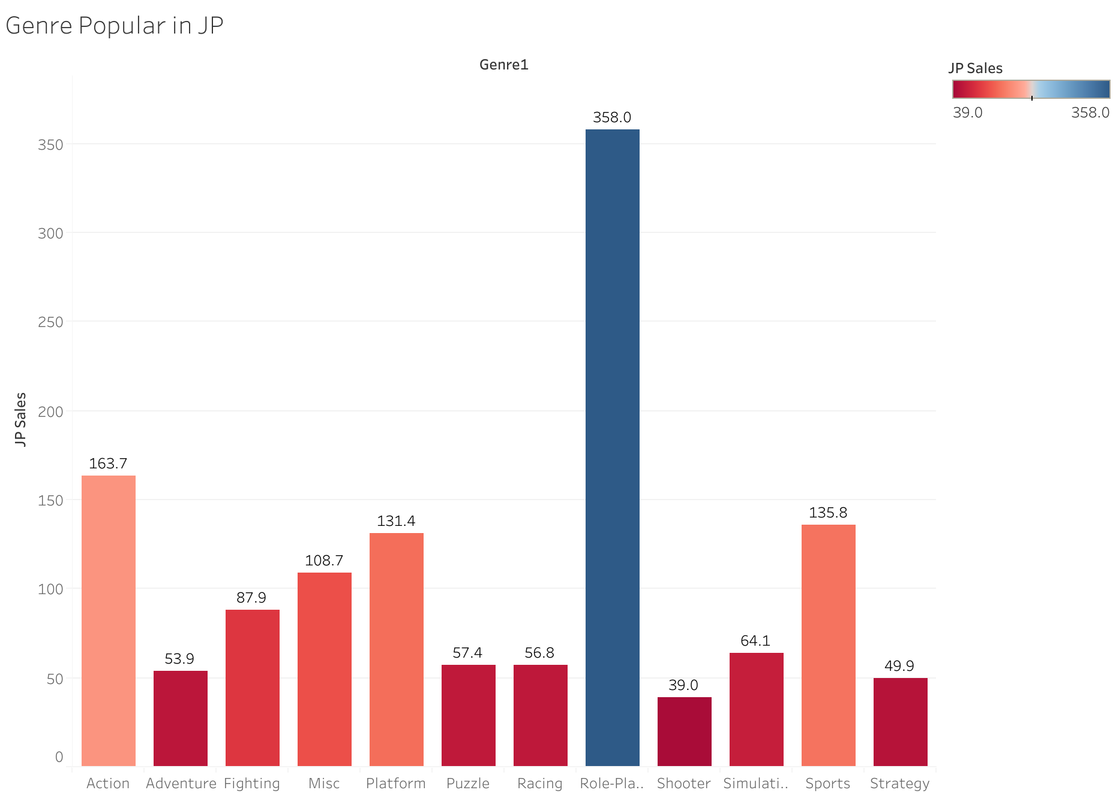
What are top selling games in Japan?
From the plot we can see that,
Role playing genre has by far the highest sales in japan.
Shooter gaming genres have the lowest sales in japan.
Although, Action genre is the most sold game all over the but it lack sales in Japan.

Slide 9
Conclusion
Role Playing is most sold in Japan, which makes japan the largest community for Role Playing Games.
Action is by far the most popular genre all over the world in terms of user count.
Action is also has the most sales all over the world.
Though Action game genre has the highest sales but in terms of player count Shooter genre comes close second.
Rise of sales in 1990’s was because of launch of Playstation 1.
Sales decline after 2008 shows that other factors were in play which have reduced the sales in Console gaming.
These other factors could be Mobile Gaming or PC games.

